Slide 1

Welcome to
DACDB & My Rotary
Sandra Early
District Executive Secretary

Slide 2


Sandra Early, District 7630 Executive Secretary
Title Page Option

Slide 3
Highlights of this presentation:
  General “lay of the land”
  Helpful hints and important notes
  Questions
  Special Notes from Sandra:
  There is always more than one way to accomplish a task in DACdb.
  Sometimes DACdb experiences a glitch in the matrix. Everyone just remain calm!
  We may discuss things today that you will delegate to someone else. That’s the joy of being the President!
  I’m going to throw a lot of information at you today. No worries! The most important info is how to get in touch if you have questions!
CONGRATULATIONS!
As you embark on your year as the
President of your Club, please know that
I am here as part of your support team!

Slide 4
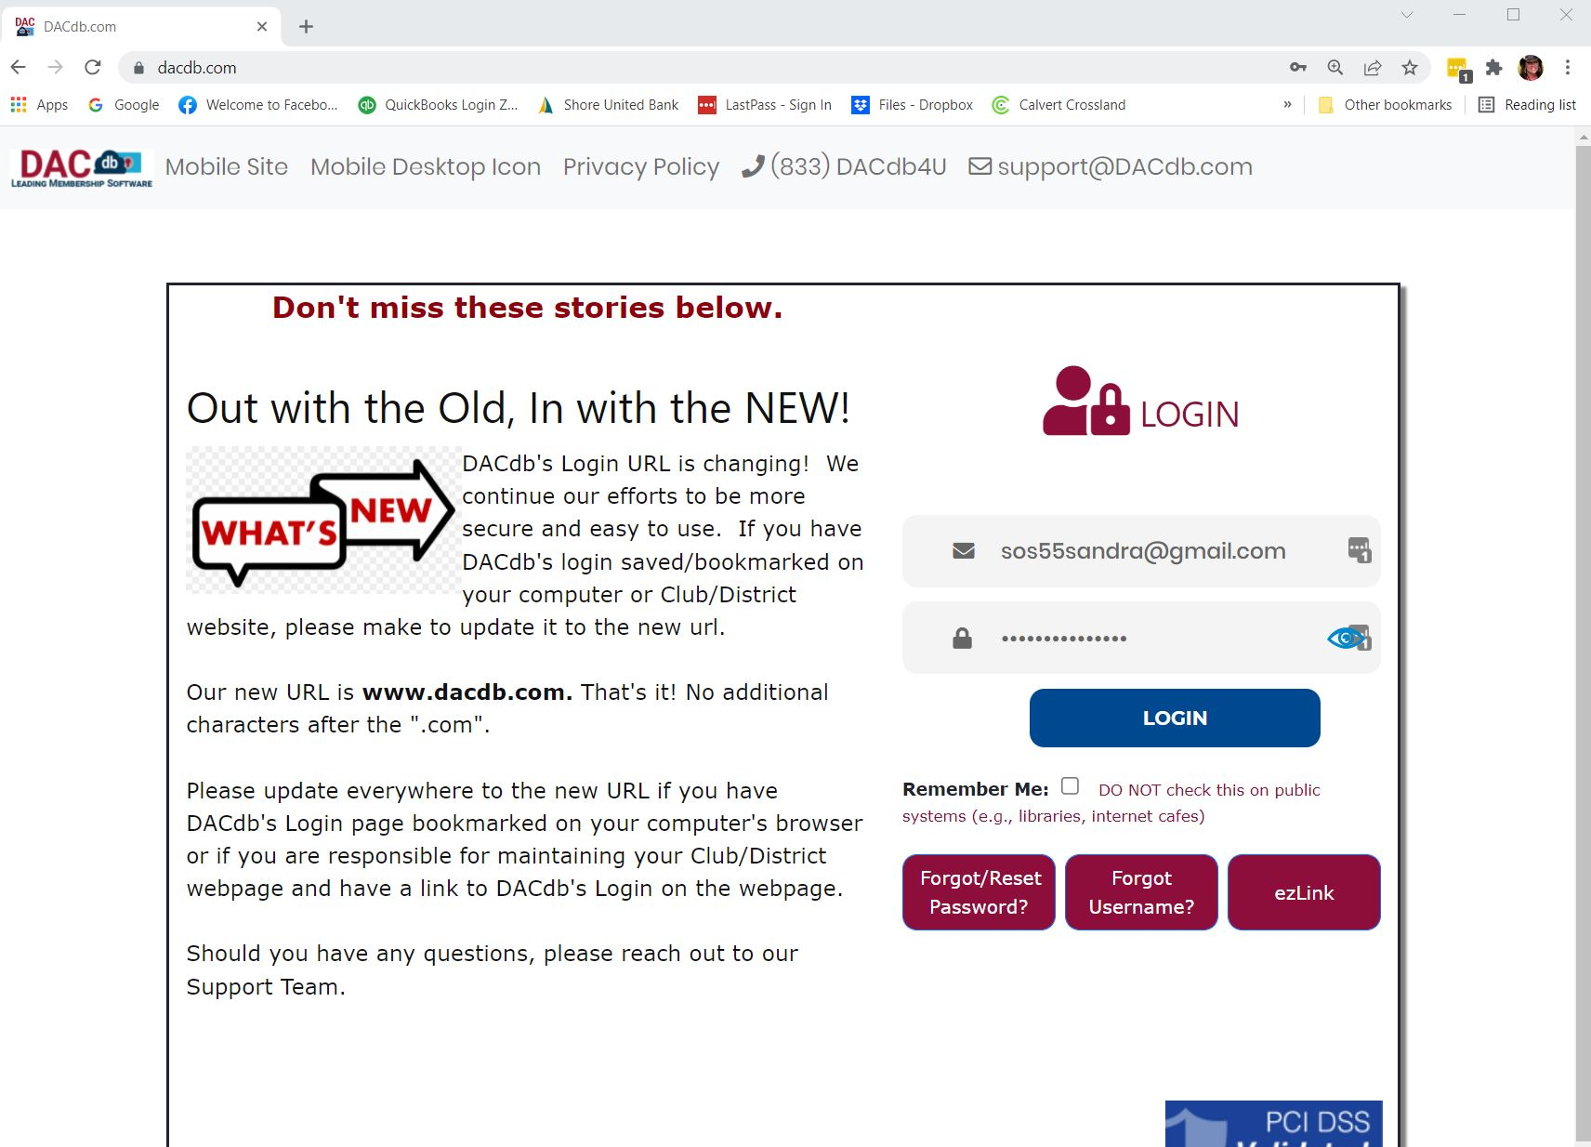
First things first!
Log into DACdb!
New login URL:
www.dacdb.com

Slide 5
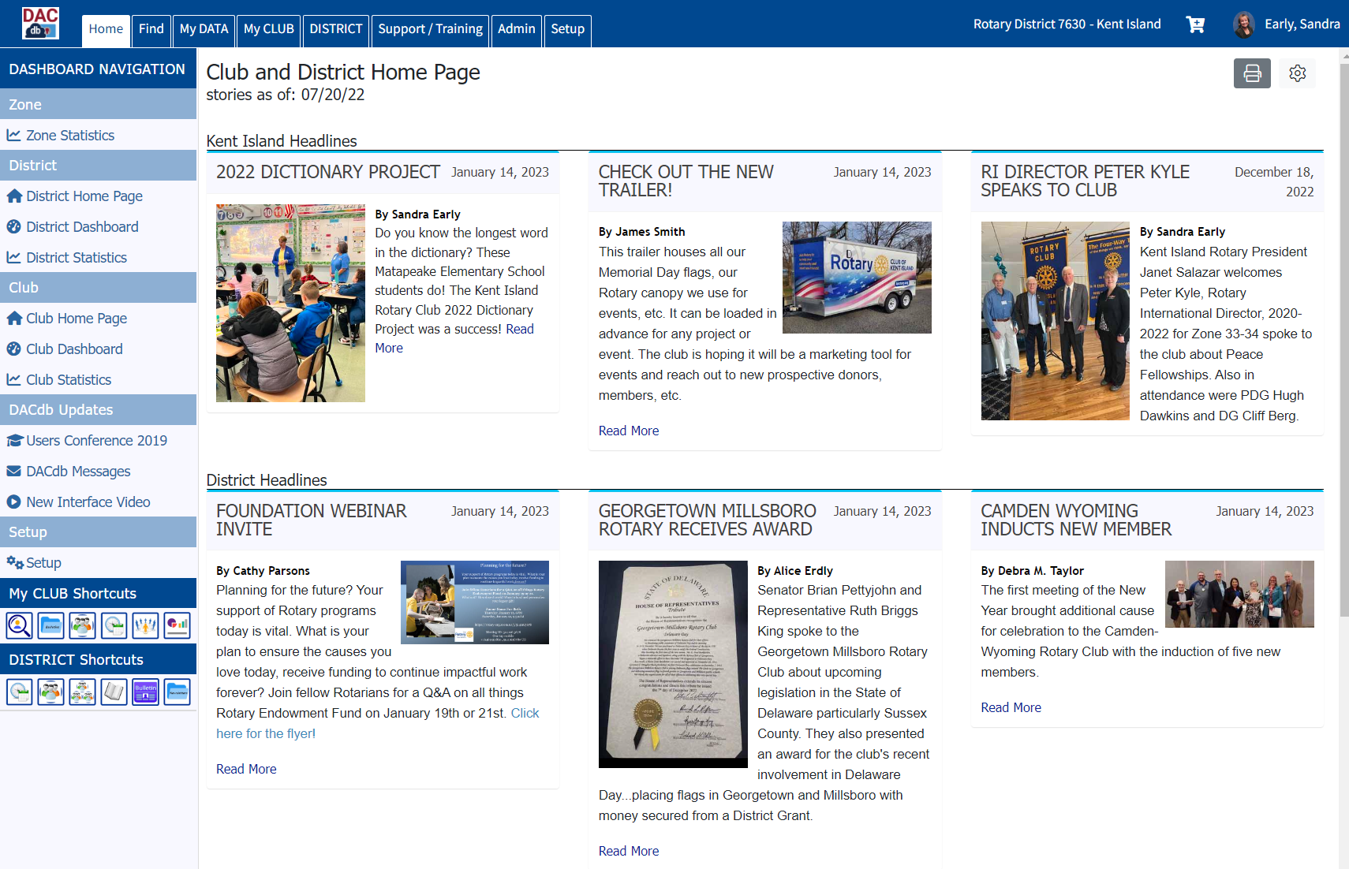

Slide 6
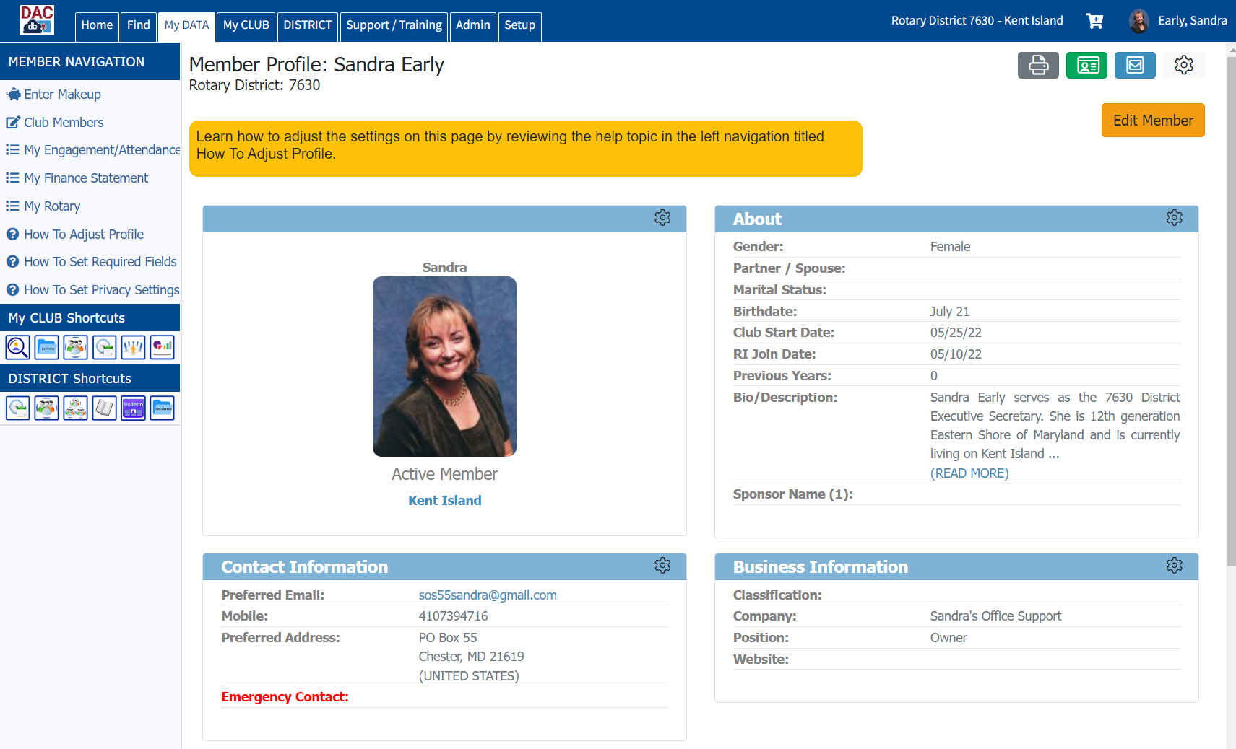
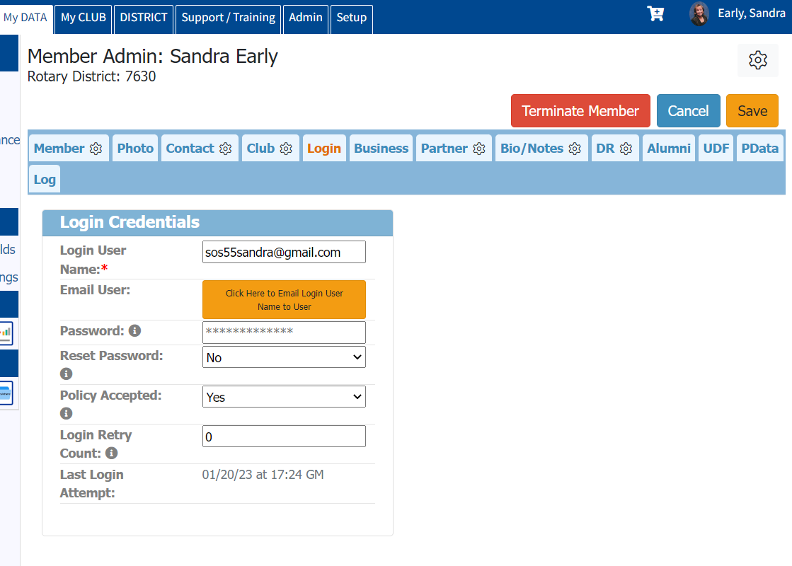
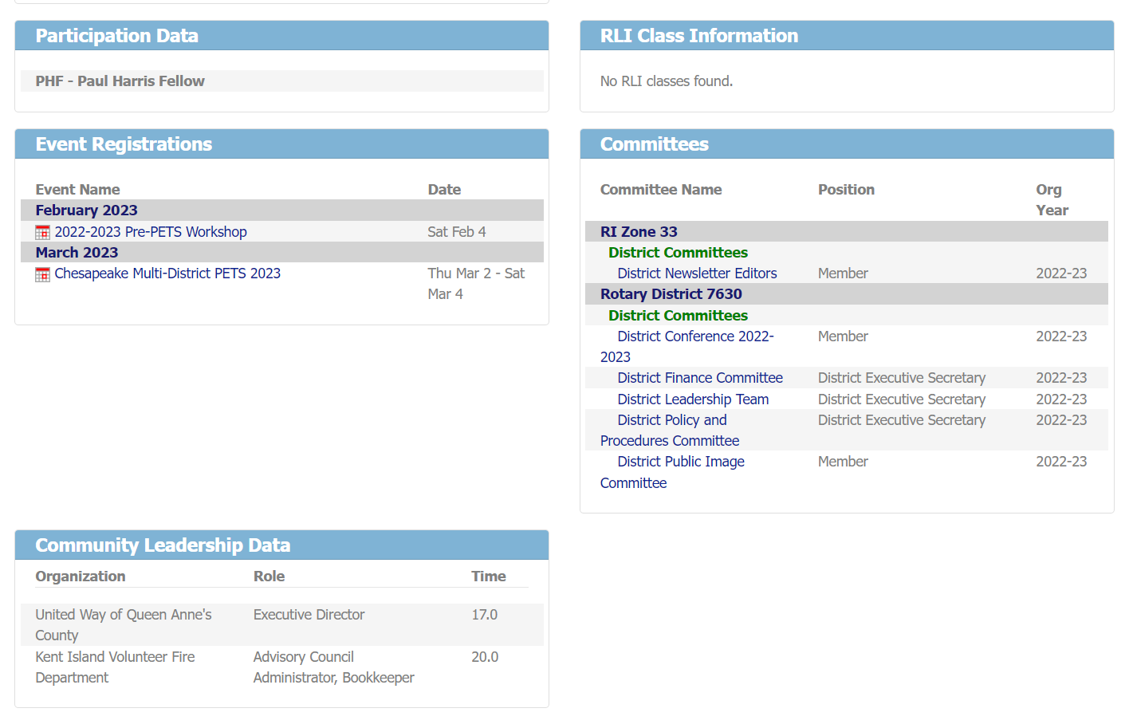

Slide 7
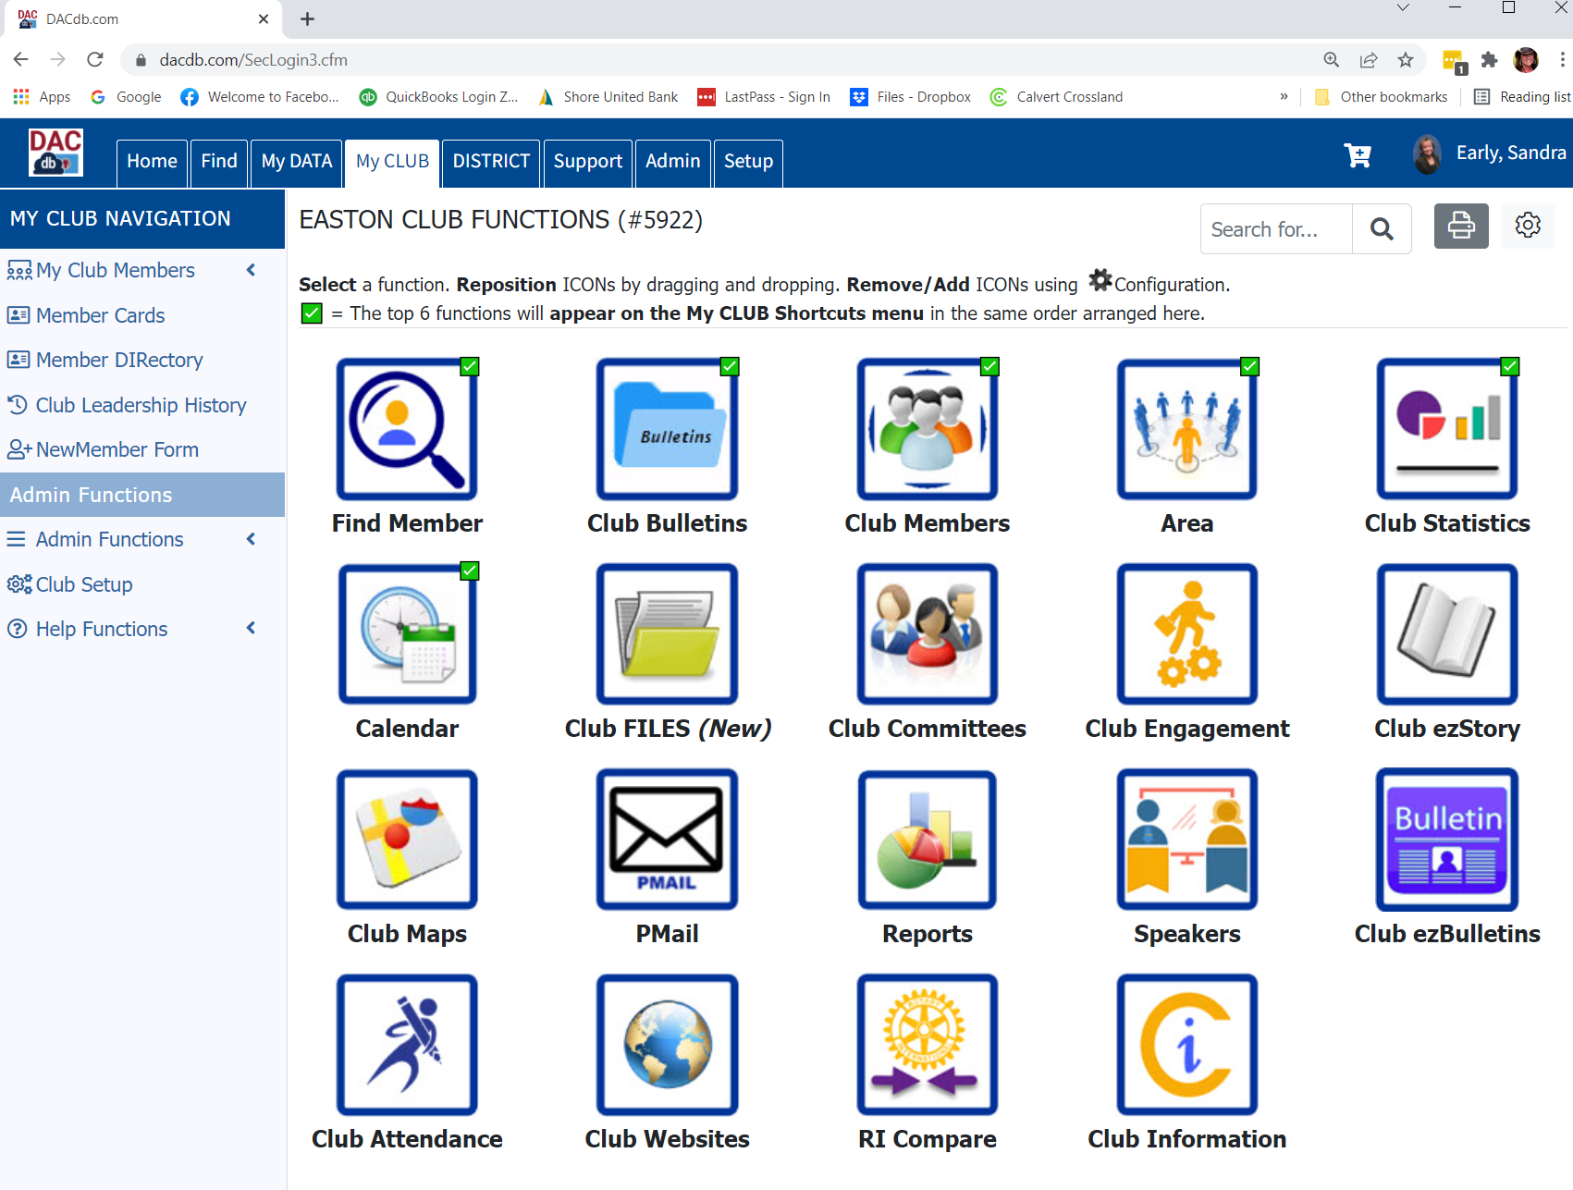
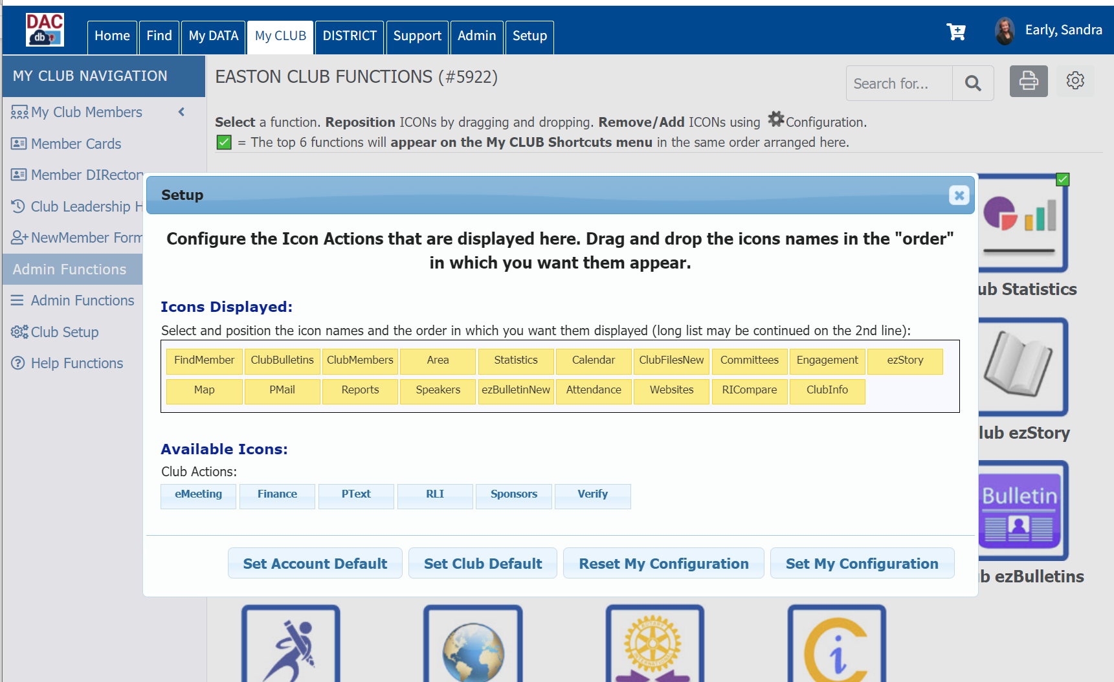

Slide 8
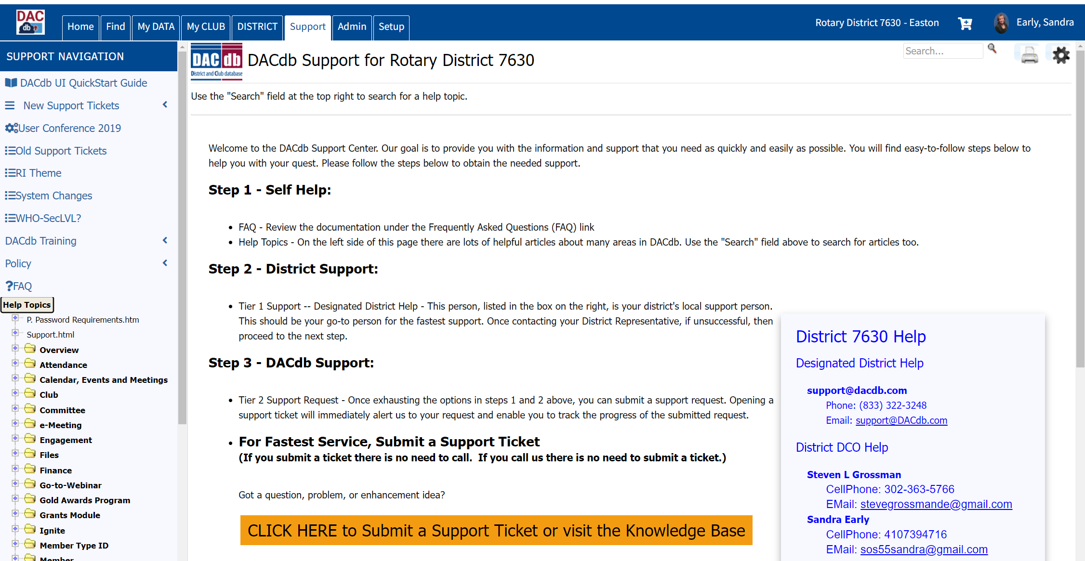

Slide 9
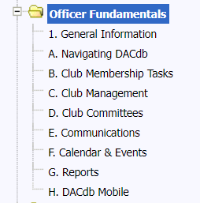
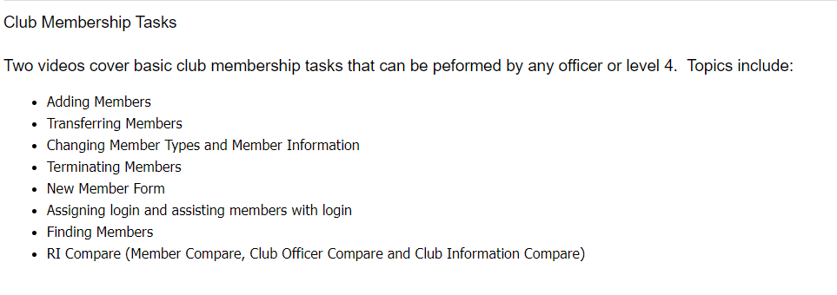
Officer Fundamentals in the Help topics…
The last two items are
Reports and DACdb Mobile App
Adding New Members is not for the faint of heart!
Find an officer who is:
Computer savvy
Patient
Have a problem-solving mind

Slide 10
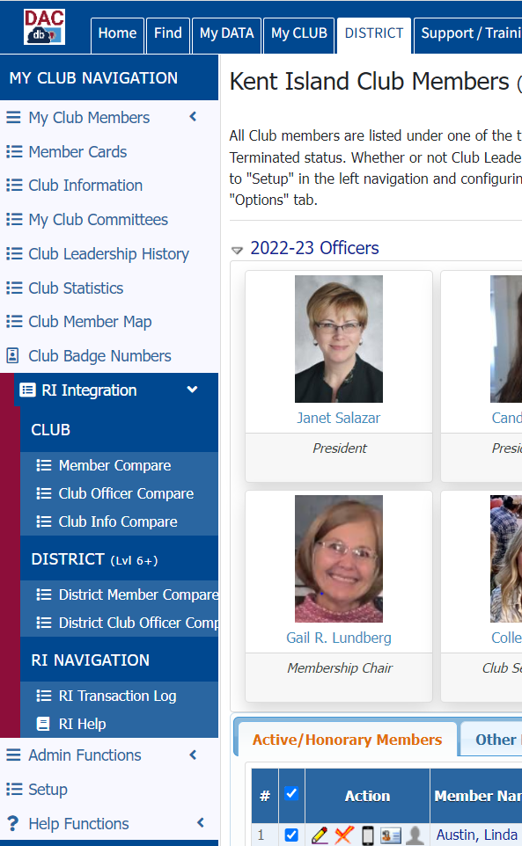
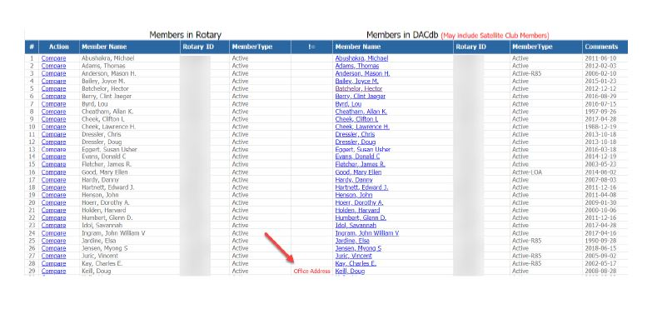
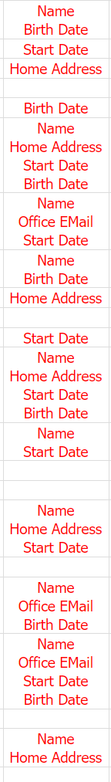
DACdb is only half the puzzle. RI or My Rotary is actually the
“Mother Ship”. Our goal in DACdb is to mirror Rotary International.
These two sites communicate with each other.

Slide 11
RI encourages you to enter members into RI first
  Have they been a member before?
  Did their previous Club “terminate” them?
  The new Club start date must be after the termination date
  A Member Compare Report will help you integrate the info into DACdb
If you enter them into DACdb first, the information should automatically be “pushed” to RI.
  Please check after 24 hours but before 30 days! In many cases the push won’t happen automatically, and the member compare report will help fix that!

Slide 12
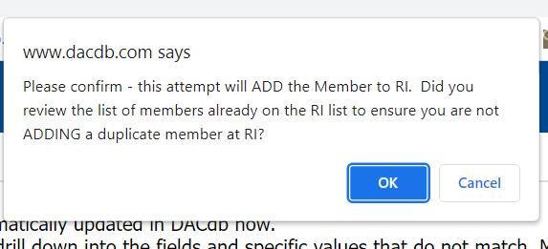
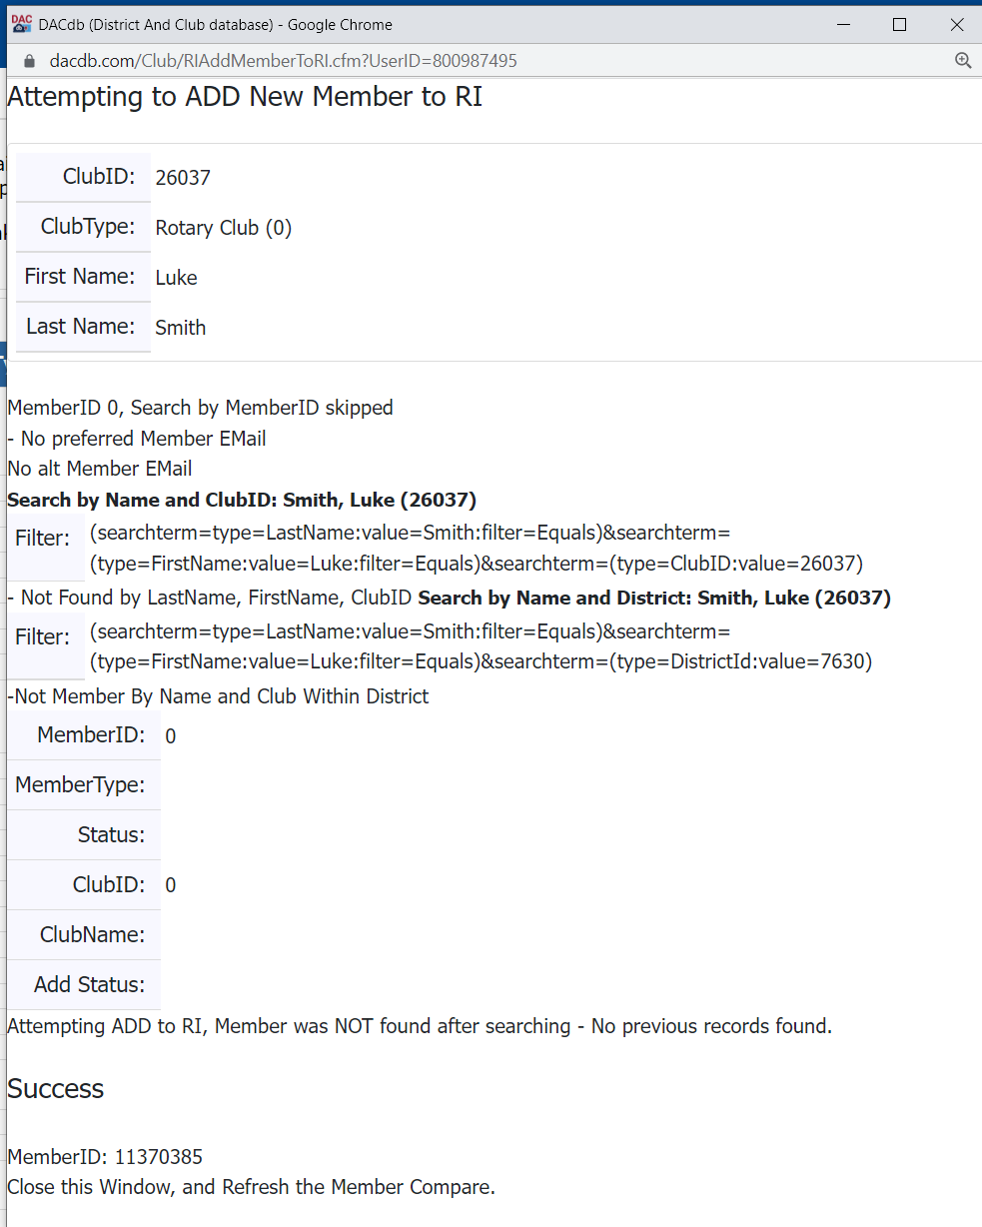
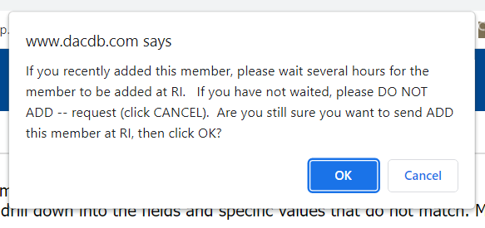

Slide 13
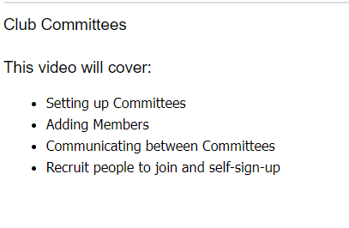
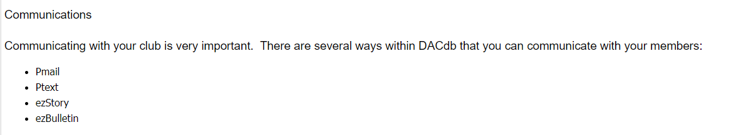
Is everyone getting their bi-weekly newsletter?

Slide 14
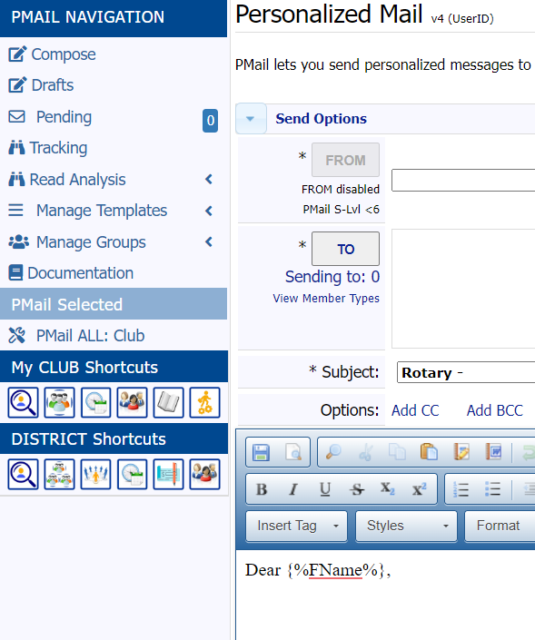
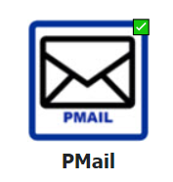
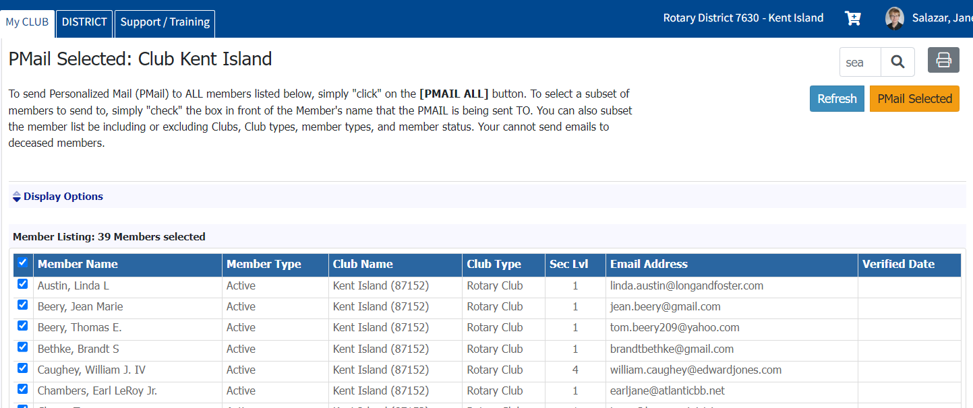

Slide 15
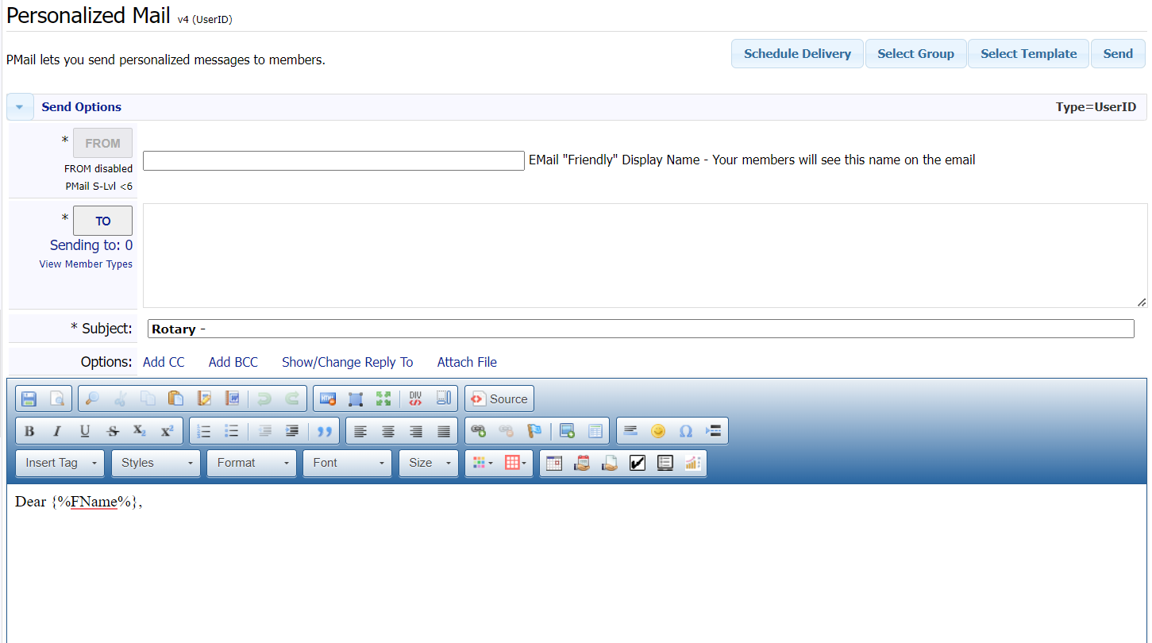
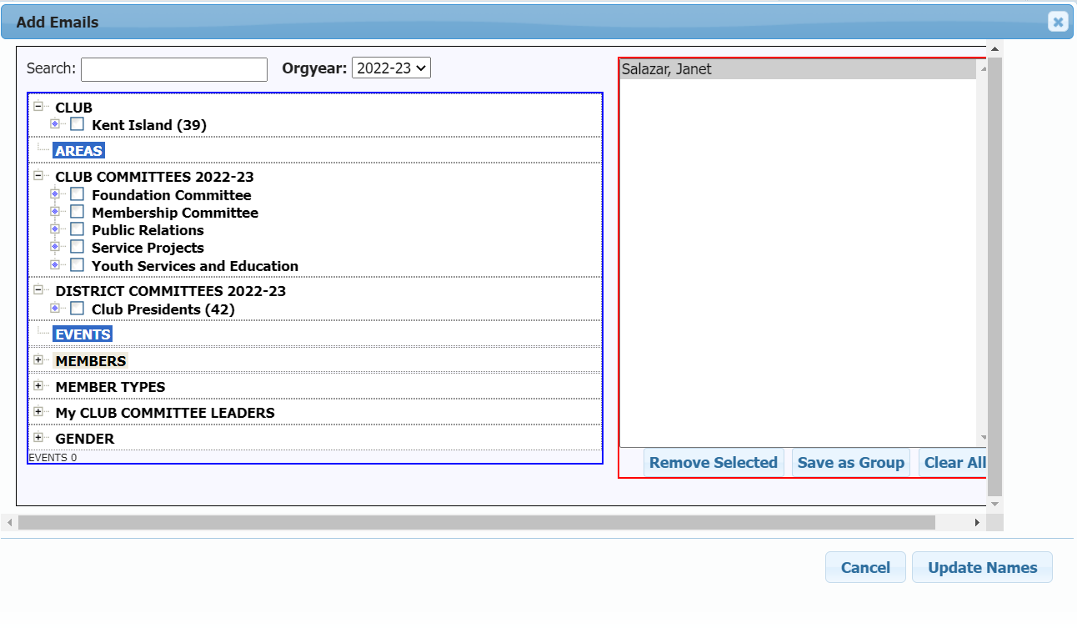
The benefit to Pmail is that you have a better
Chance of your bulk communications
not being flagged as spam.

Slide 16
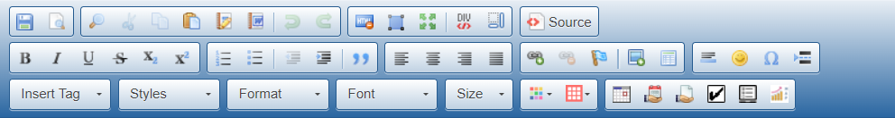
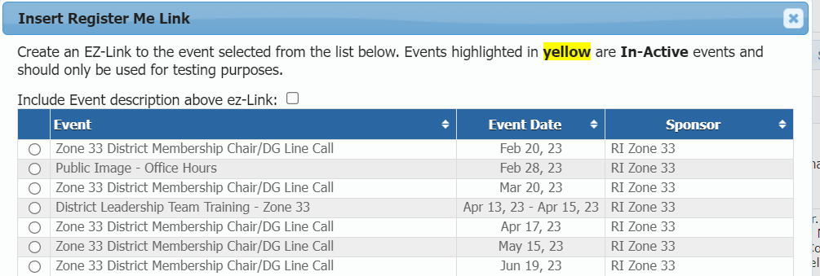
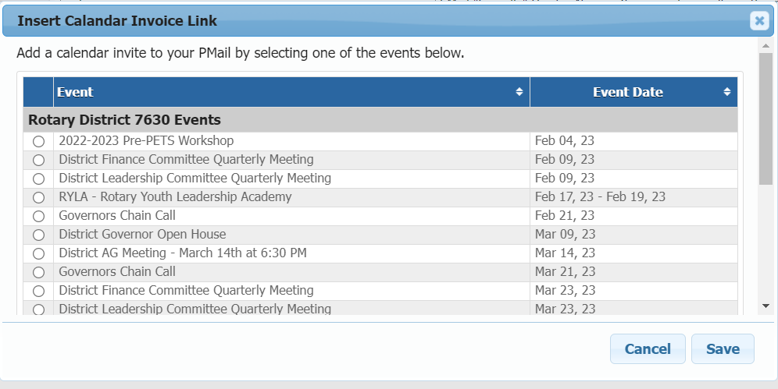

Slide 17
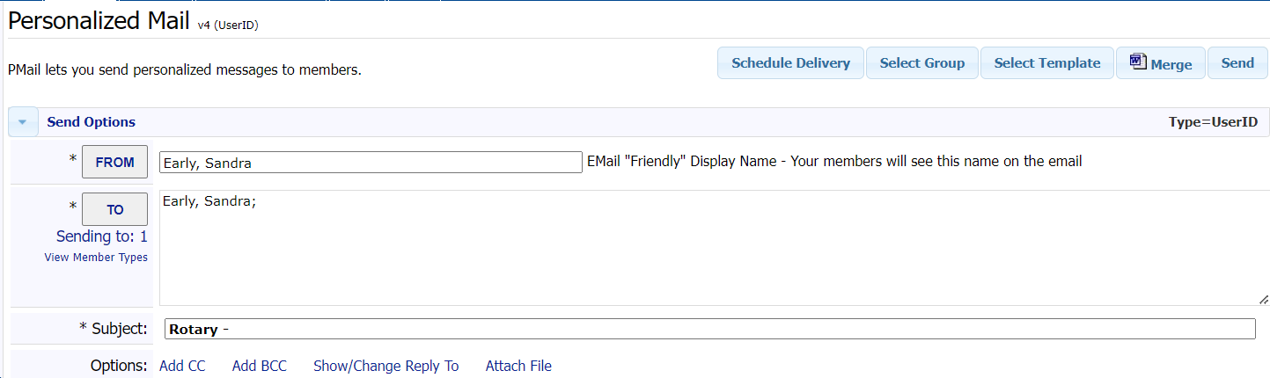
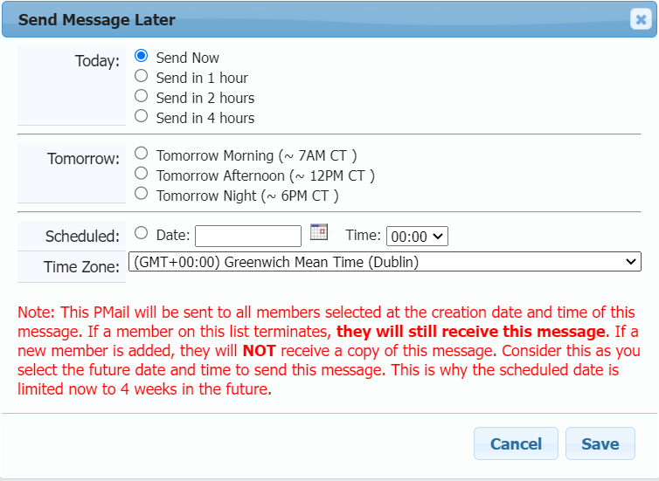
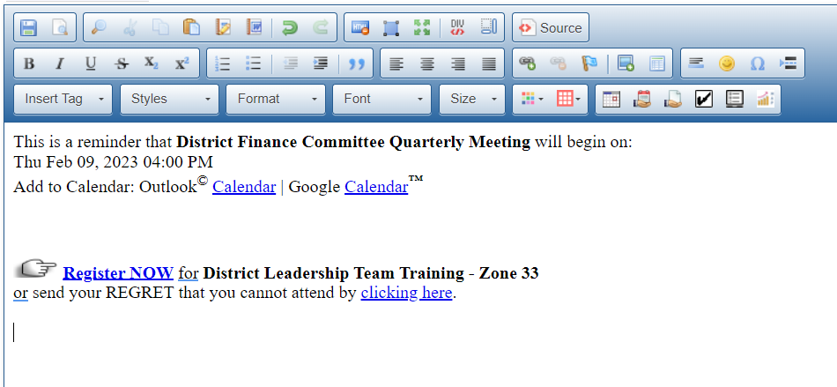
Clicking send is
always the last
thing you do!

Slide 18
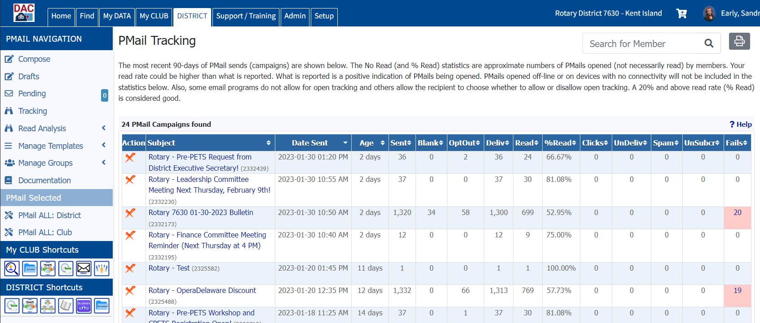
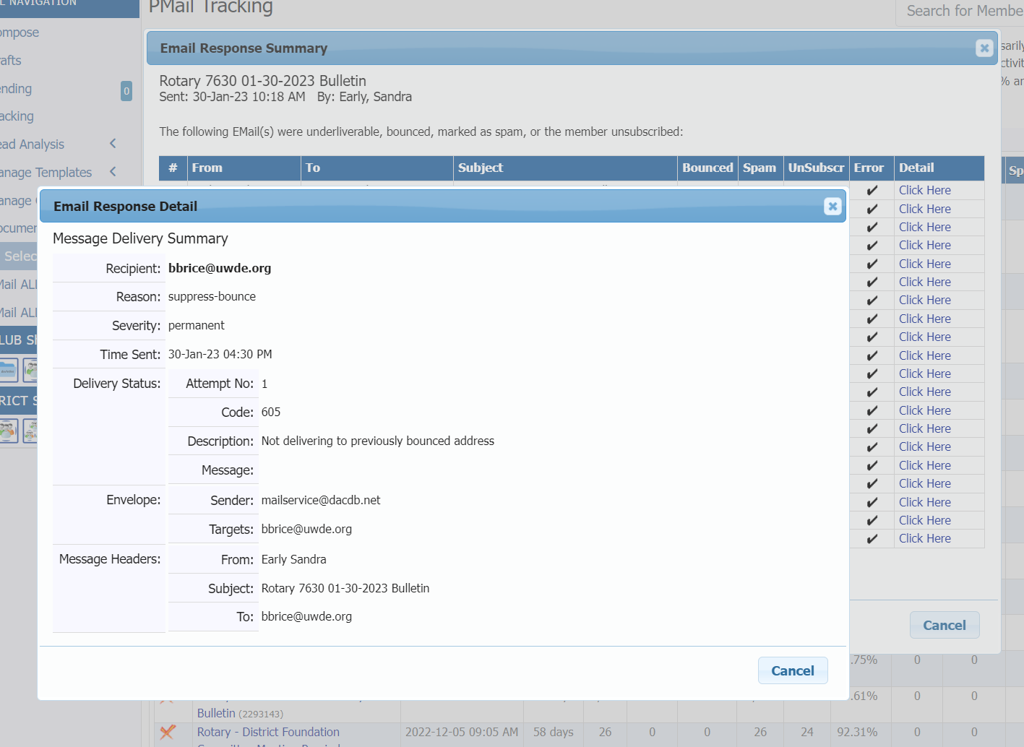
It has come to my attention that you are not receiving your emails from the District through the DACdb database.
If you would like to get the bi-weekly emails or emails from the District and Club leadership, please have the email
mailservice@dacdb.net removed from your spam list. (When someone emails you from DACdb, it originates from
that email so that is the address that is being suppressed.)
You may have to contact your email provider to have them walk you through this process.
Once it is corrected on your end, let me know and I will go to DACdb and have them taken off their suppression list.
mailservice@dacdb.net

Slide 19

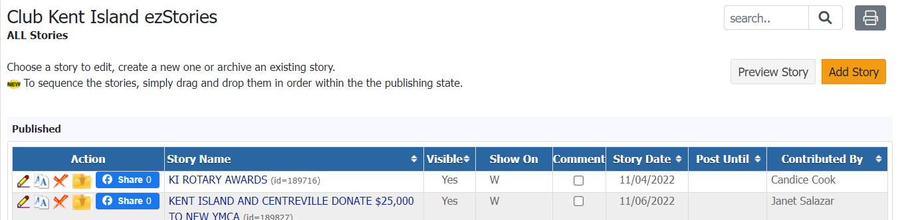

Slide 20
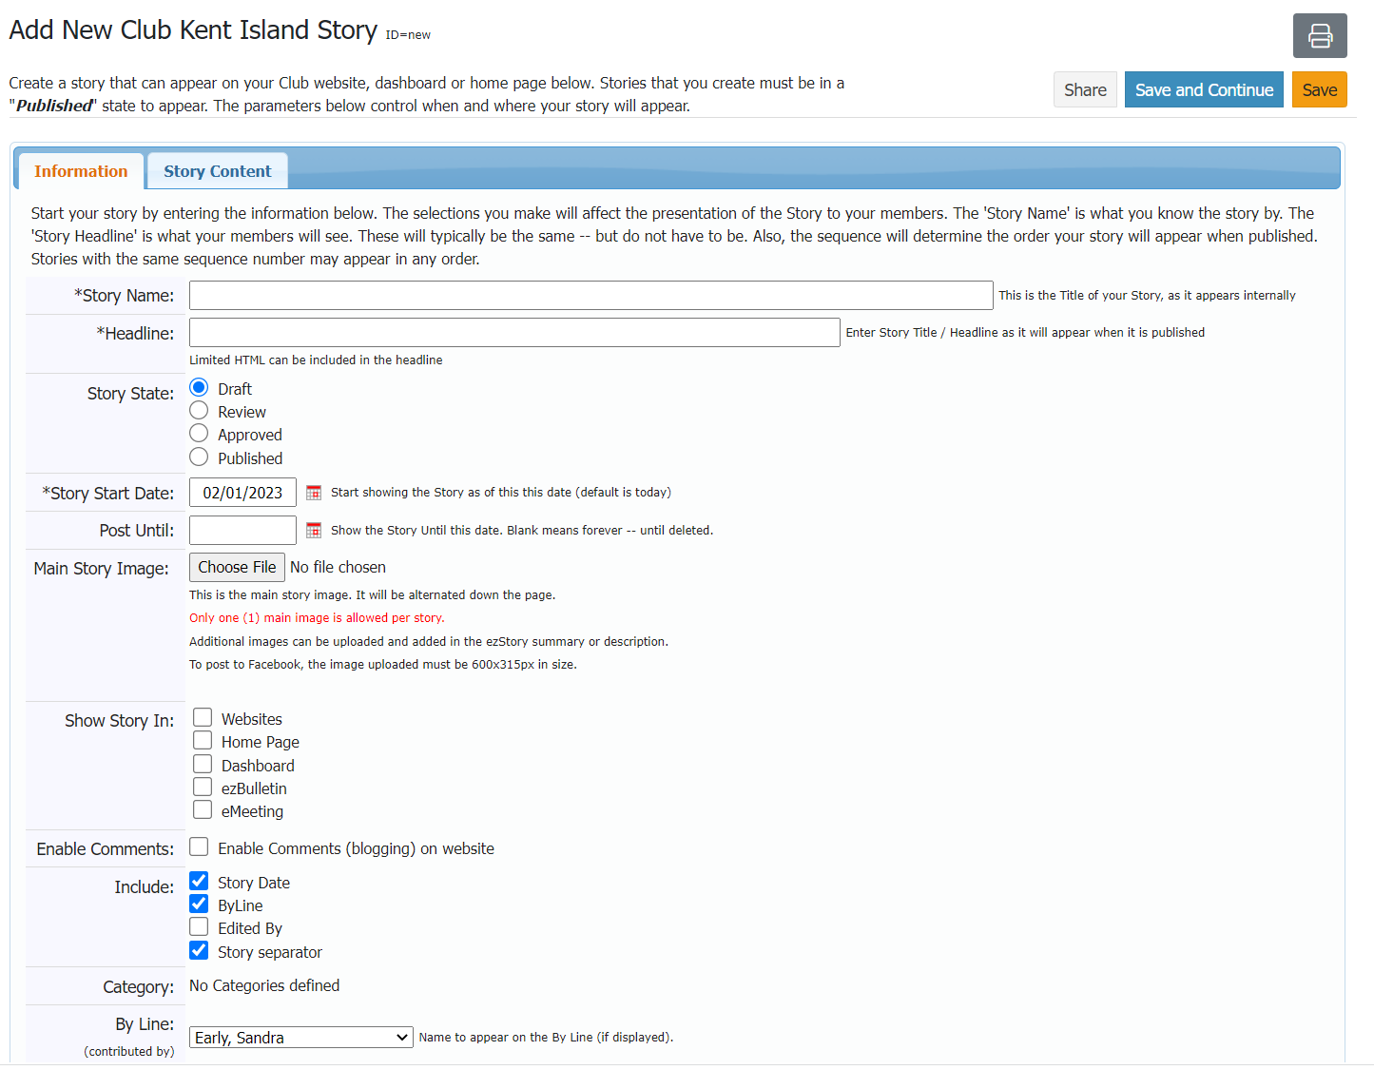
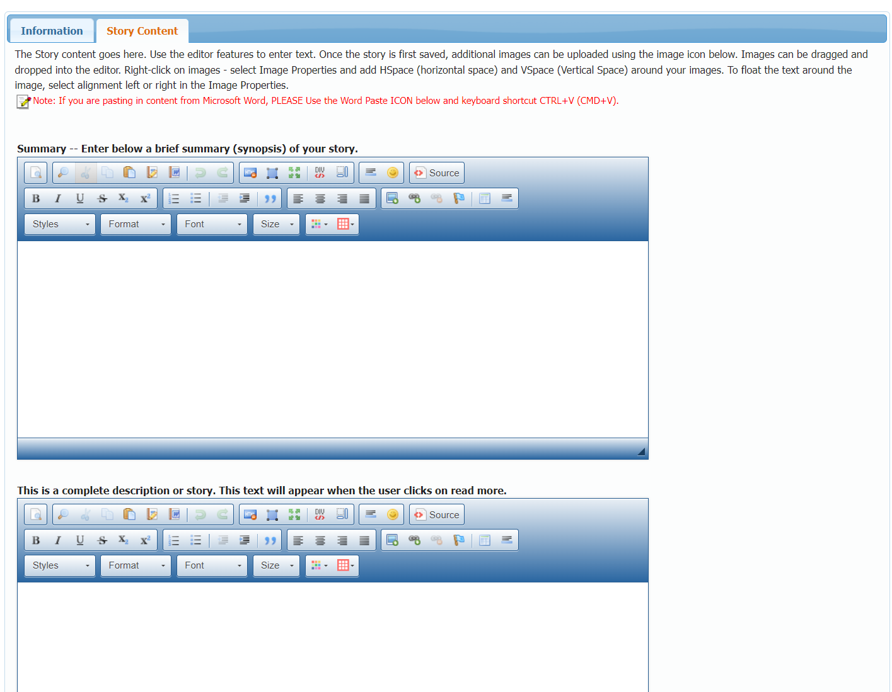
This is what readers will see to entice them to read
your story. Typically, the first line of the story.
This is what they will see when they click to “Read More”

Slide 21
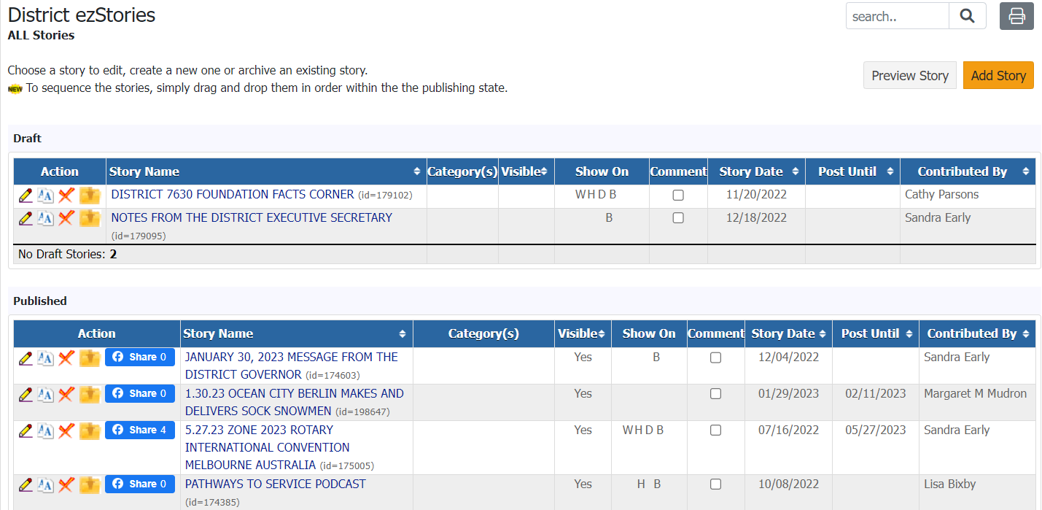

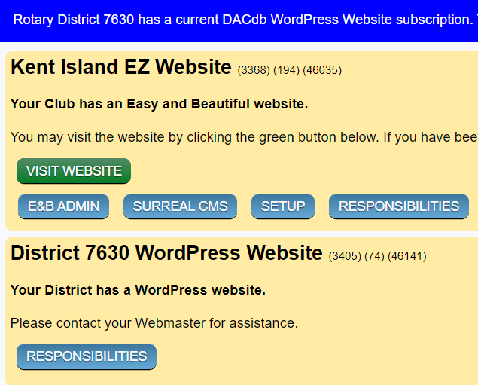
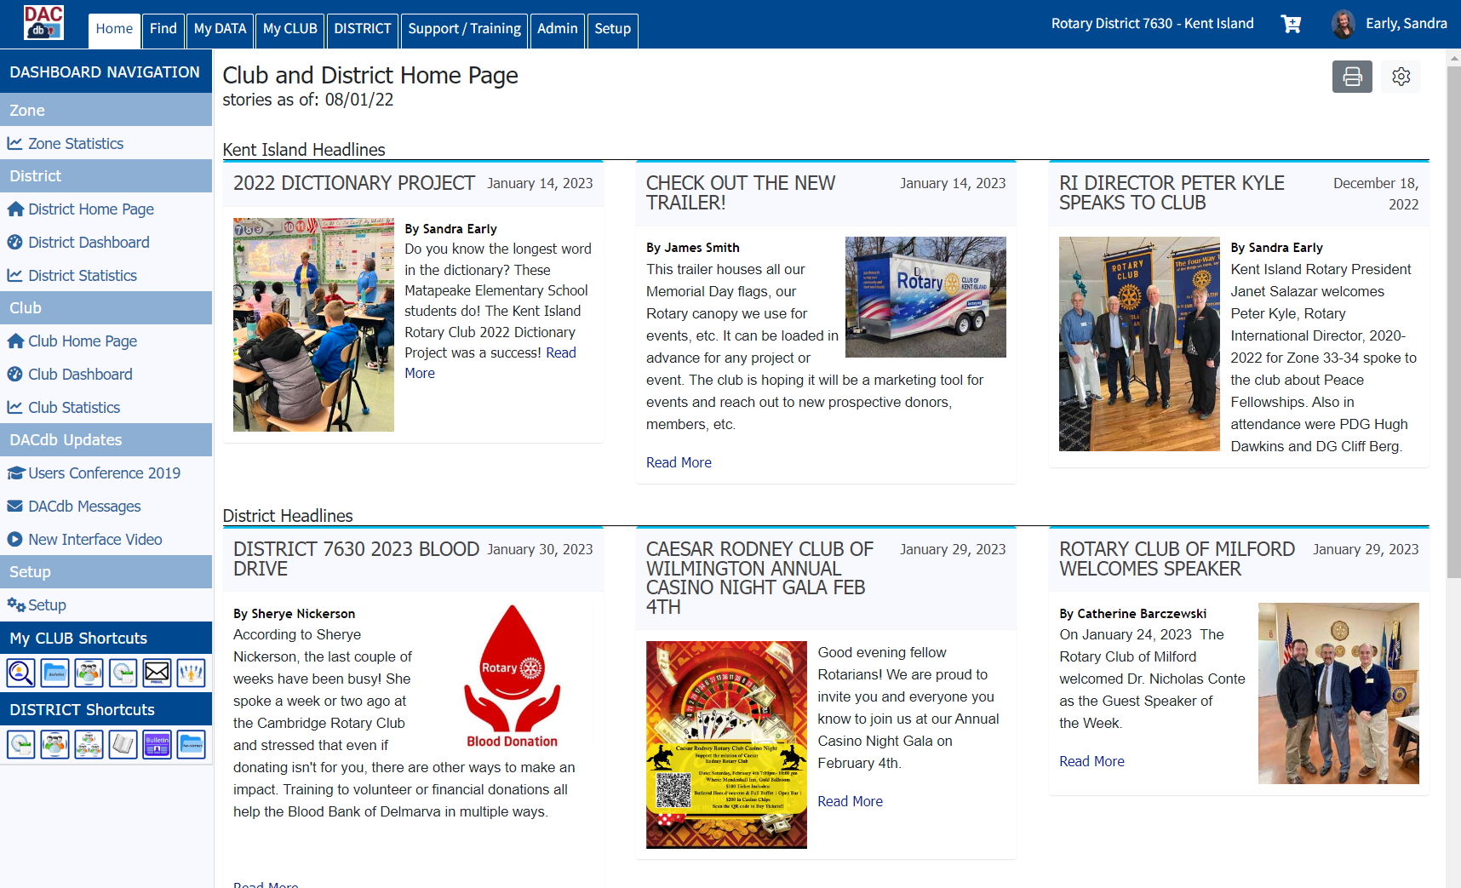
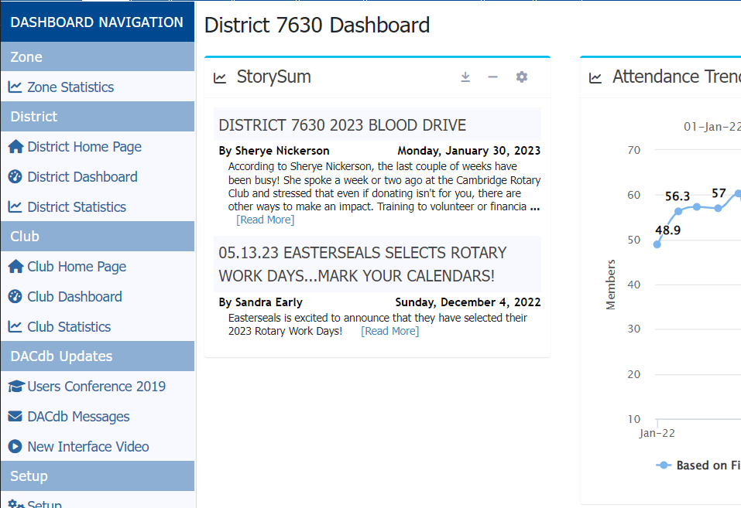

Slide 22
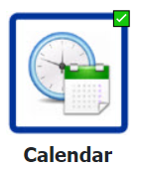
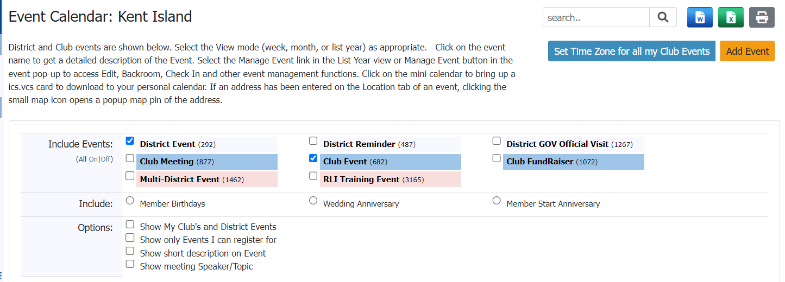

Slide 23
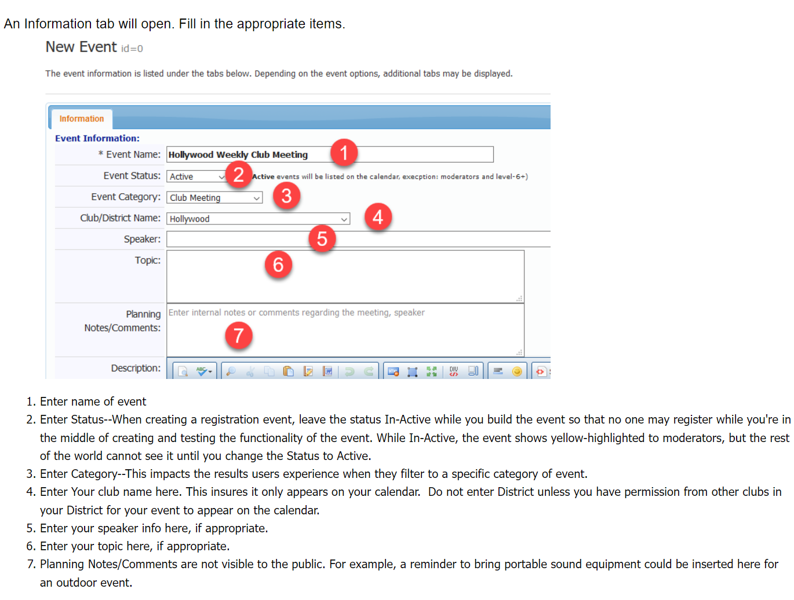
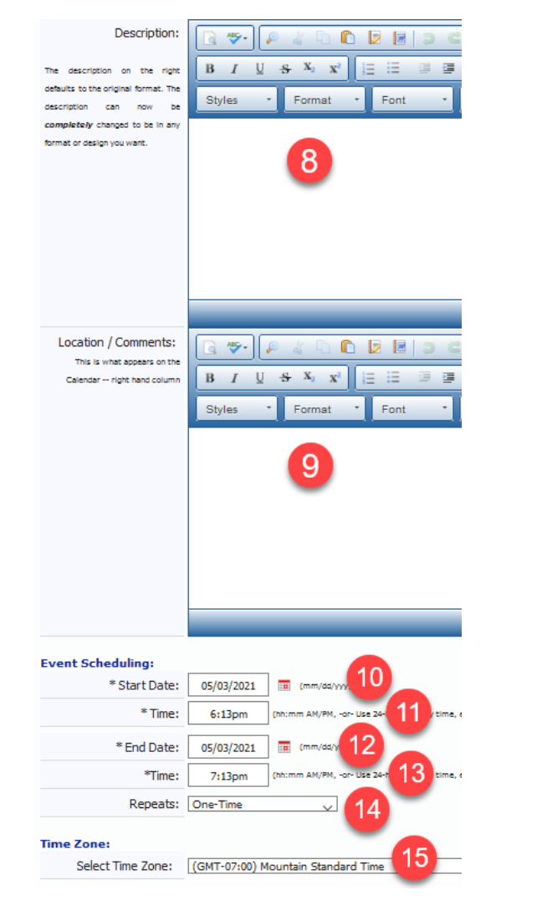
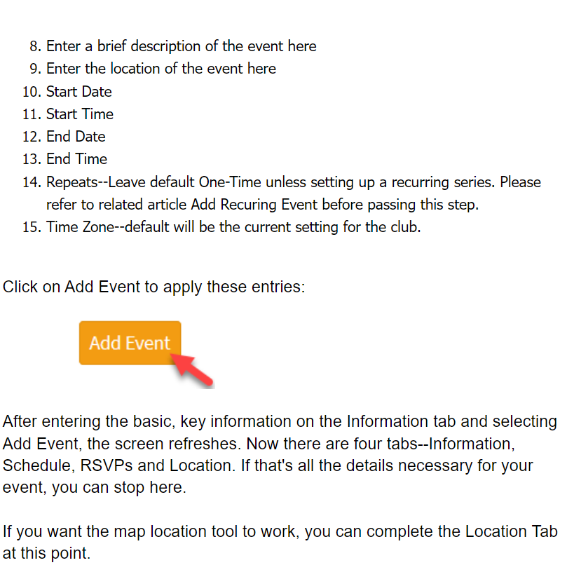

Slide 24
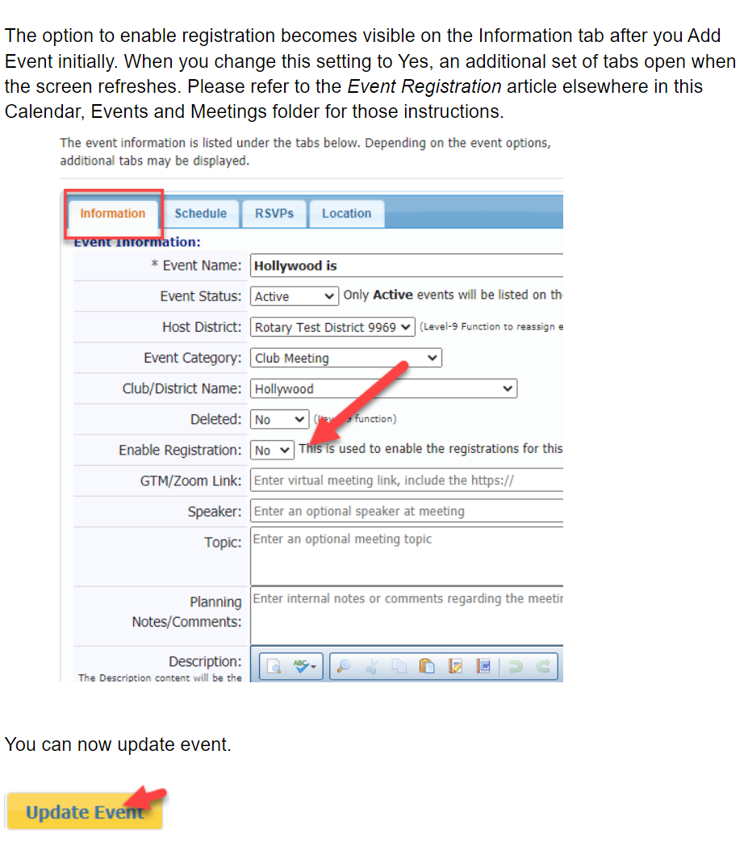
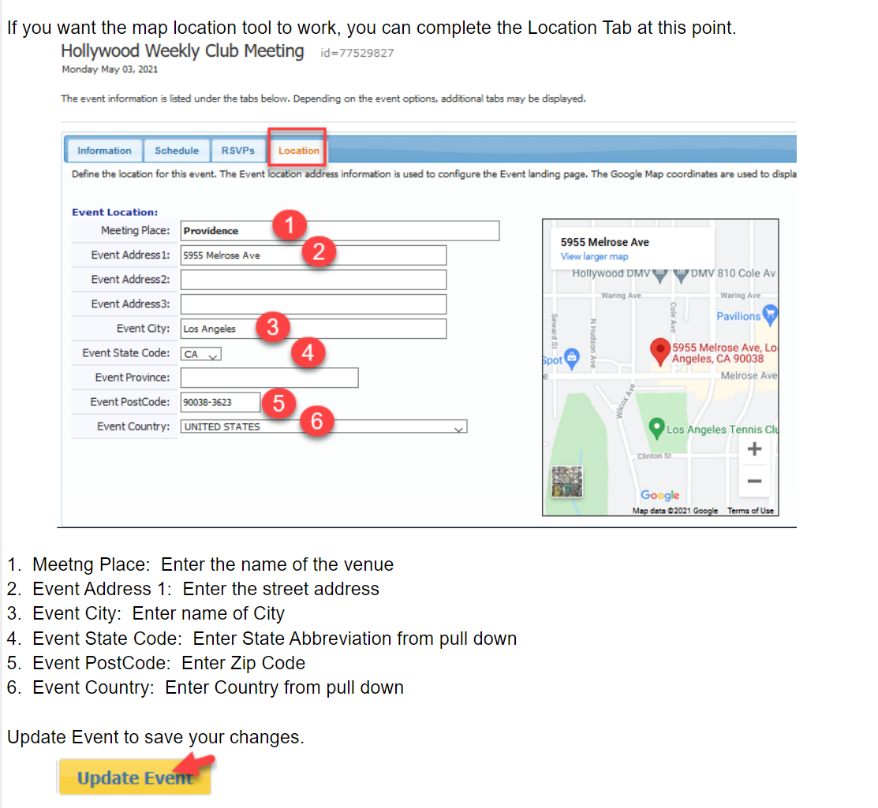

Slide 25



Need help, but it’s not urgent?
Search the support tab
Email DACdb support
Call or Email Sandra – No more than 24 hours
Would like help sooner rather than later?
Right Now! = Call DACdb
ASAP = Text Sandra

Slide 26
QUESTIONS?

